Slide 1
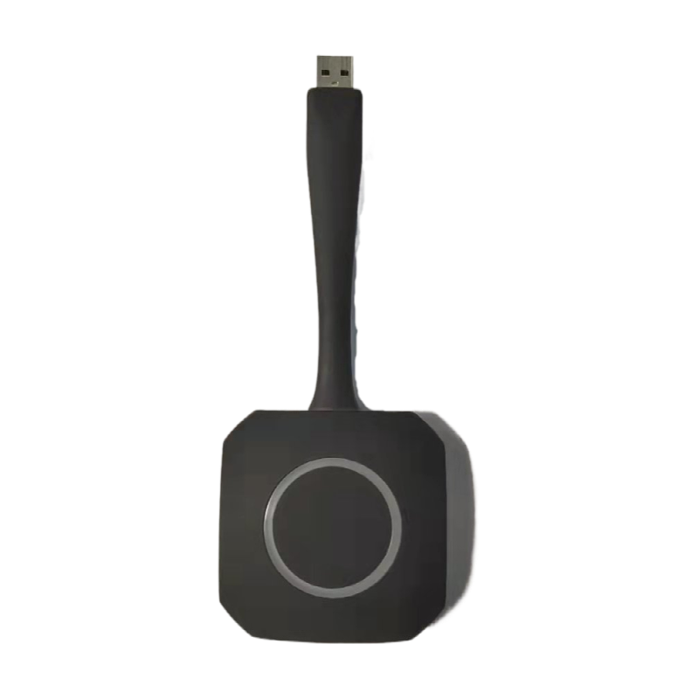
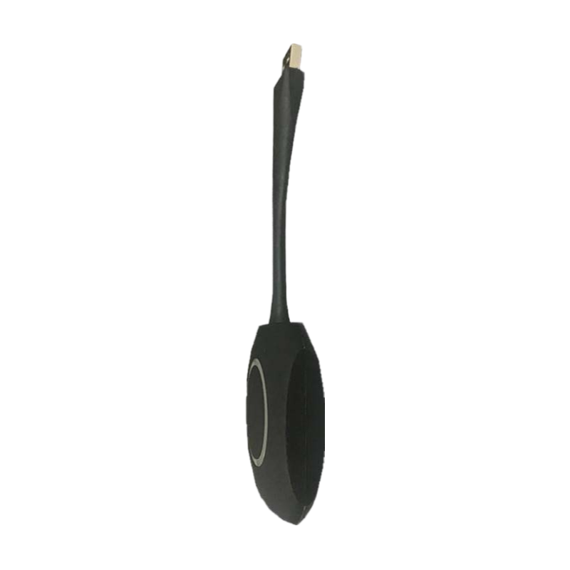
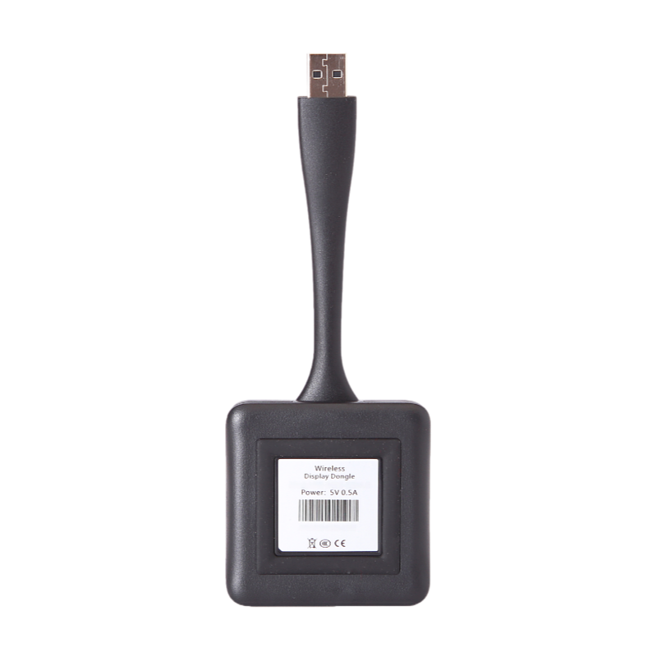
Wireless Screen Dongle
Specification
No | Item | Description
1 | Operation system | Windows 7 /8/8.1/10; MAC OS X 10.6 & Above
2 | Color | Black
3 | Applicable to | Airplay business; teaching
4 | WIFI frequency | 5G/2.4G dual frequency
5 | Input resolution | 1920 * 1080
6 | Output resolution | 1920 * 1080 & 3840 * 2160
7 | Audio transmission | Support
8 | Wireless transation protocol | IEEE 802.11 a/g/n
9 | Wireless transation speed | Up to 300Mbps
10 | How it works | Connect the wireless dongle with interactive flat panel Connect the wireless dongle with computer and it automatically starts the software. Tap the dongle to get started

